Slide 1
INST 414: Data Science Techniques Naïve Bayes

Slide 2
Intro to the Machine Learning Pipeline

Slide 3
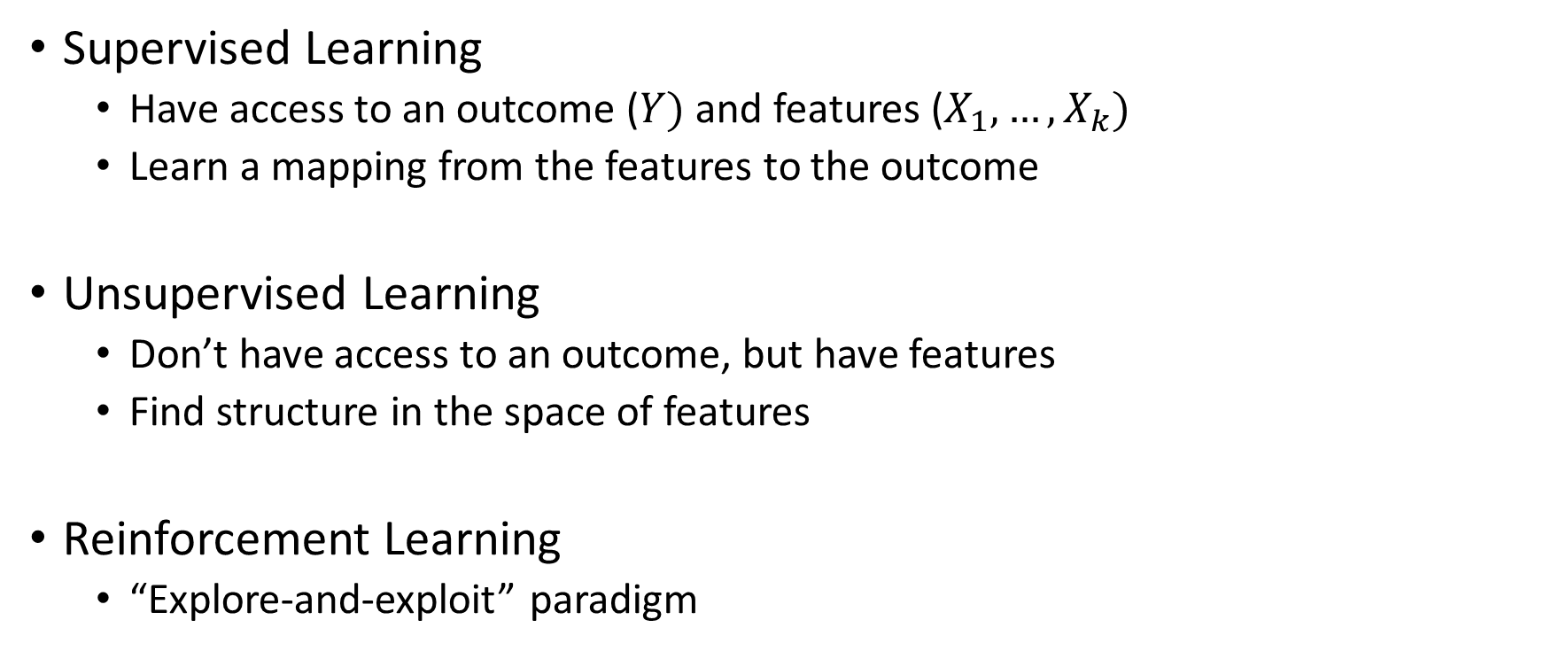
Different Types of Machine Learning
Supervised Learning
Have access to an outcome ($Y)$ and features ($X_{1},…,X_{k})$
Learn a mapping from the features to the outcome
Unsupervised Learning
Don’t have access to an outcome, but have features
Find structure in the space of features
Reinforcement Learning
“Explore-and-exploit” paradigm

Slide 4
Supervised Learning
Predict an outcome (or outcomes)
Types of outcomes
Binary (predicting re-arrest)
Multinomial (predicting what type of phone to recommend)
Continuous (predicting purchase price)
Structured (predicting what type of phone to recommend AND purchase price)

Slide 5
The Prediction Model Building Cycle
Clean Data
Define Outcome
Feature Generation
Evaluate
Train Model
Predict on Held-Out Data
Notes:
This assumes that

Slide 6
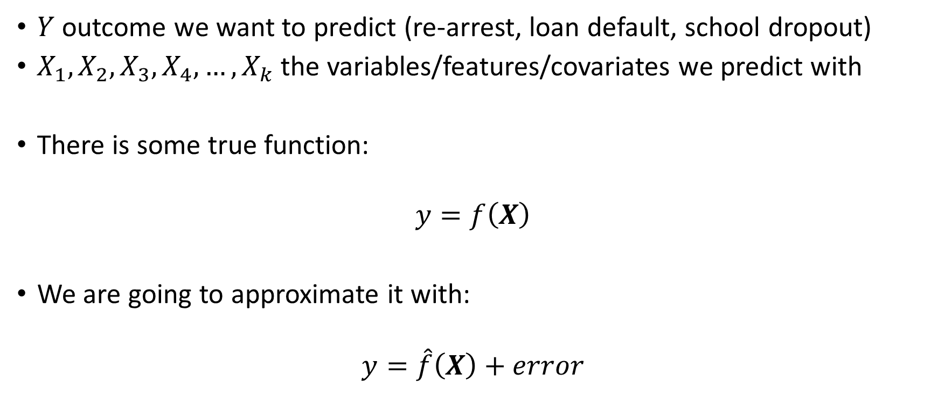
Model Training
$Y$ outcome we want to predict (re-arrest, loan default, school dropout)
$X_{1}, X_{2},X_{3},X_{4},…,X_{k}$the variables/features/covariates we predict with
There is some true function:
$$y=f\left(X\right)$$
We are going to approximate it with:
$$y=\hat{f}\left(X\right)+error$$

Slide 7
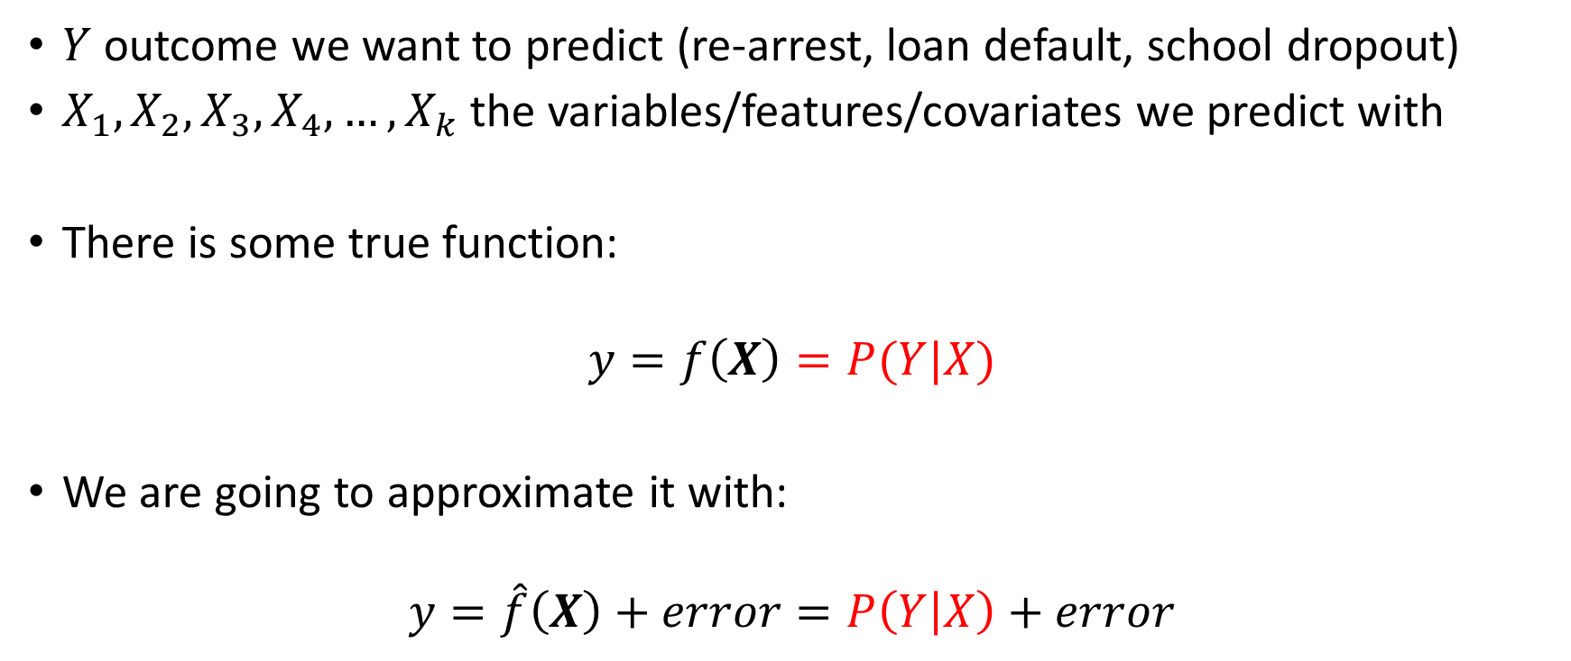
Model Training
$Y$ outcome we want to predict (re-arrest, loan default, school dropout)
$X_{1}, X_{2},X_{3},X_{4},…,X_{k}$the variables/features/covariates we predict with
There is some true function:
$$y=f\left(X\right)=P(Y|X)$$
We are going to approximate it with:
$$y=\hat{f}\left(X\right)+error=P\left(Y | X\right)+error$$

Slide 8
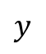
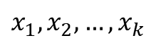
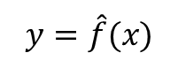
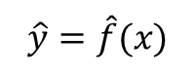

The Prediction Model Building Cycle
Clean Data
Define Outcome
$$x_{1},x_{2},…, x_{k}$$
$$y$$
Feature Generation
$$TPR$$
$$PPV$$
$$FPR$$
$$FNR$$
Evaluate
Train Model
$$y=\hat{f}(x)$$
Predict on Held-Out Data
$$\hat{y}=\hat{f}(x)$$
Notes:
This assumes that

Slide 9

How Do We Build $\hat{f}\left(X\right)?$
Via machine learning algorithms (aka statistical learning models)
Examples:
Naïve Bayes
Linear Regression
Logistic Regression
Regularized Linear Regression (e.g. Lasso)
Random Forest
Gradient Boosting
Support Vector Machine
Neural Network/Deep Learning

Slide 10
Naïve Bayes

Slide 11
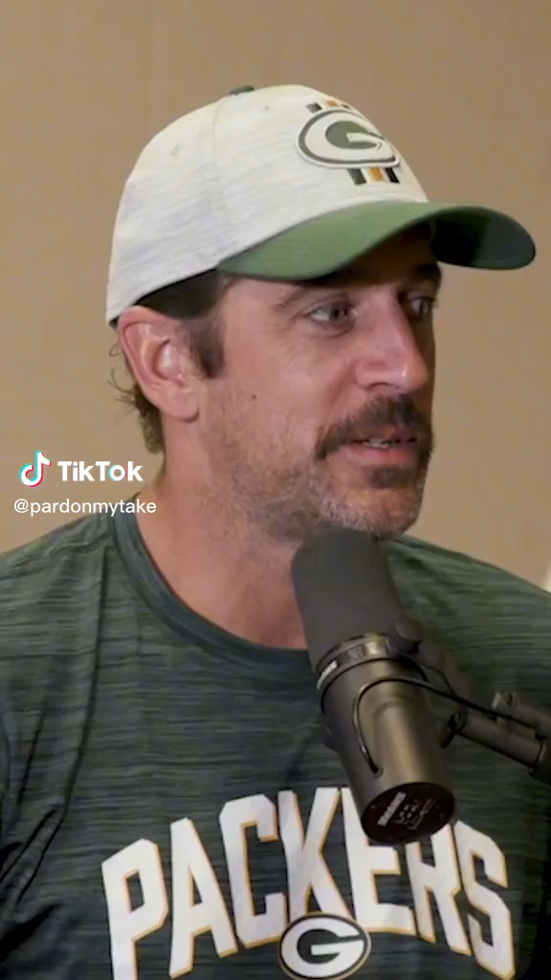


A prediction problem
Dog Videos
Sports Videos

Slide 12
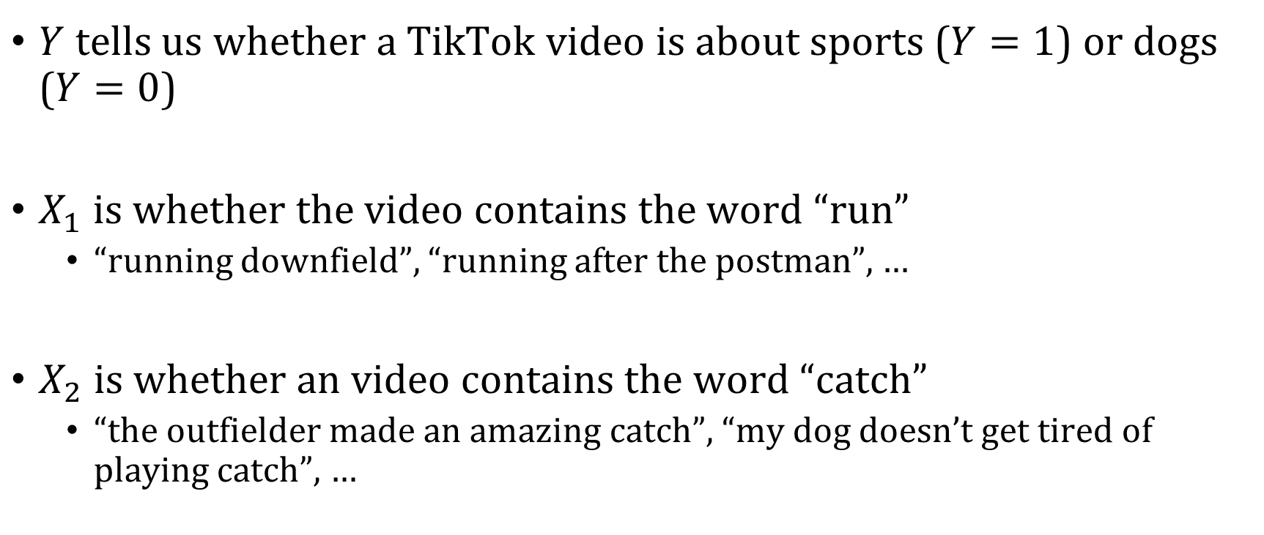
A prediction problem
$Y$ tells us whether a TikTok video is about sports ($Y=1$) or dogs ($Y=0$)
$X_{1}$ is whether the video contains the word “run”
“running downfield”, “running after the postman”, …
$X_{2}$ is whether an video contains the word “catch”
“the outfielder made an amazing catch”, “my dog doesn’t get tired of playing catch”, …

Slide 13
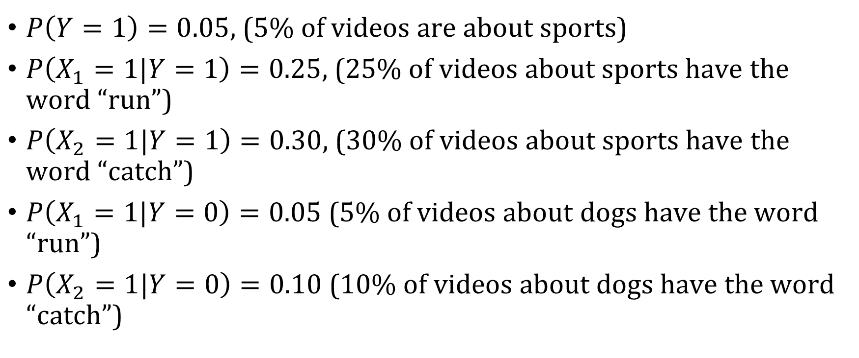
Estimates from the data
$P\left(Y=1\right)=0.05$, (5% of videos are about sports)
$P\left(X_{1}=1|Y=1\right)=0.25$, (25% of videos about sports have the word “run”)
$P\left(X_{2}=1|Y=1\right)=0.30$, (30% of videos about sports have the word “catch”)
$P\left(X_{1}=1|Y=0\right)=0.05$ (5% of videos about dogs have the word “run”)
$P\left(X_{2}=1|Y=0\right)=0.10$ (10% of videos about dogs have the word “catch”)

Slide 14
How should we classify a new video with the words “run” and “catch”?
$P\left(Y=1 | X_{1}=1,X_{2}=1\right)>P(Y=0|X_{1}=1, X_{2}=1 )$

Slide 15
How should we classify a new video with the words “run” and “catch”?
$$P\left(Y=1 | X_{1}=1,X_{2}=1\right)=\frac{P\left(X_{1}=1, X_{2}=1 , Y=1\right)}{P(X_{1}=1,X_{2}=1)}$$

Slide 16
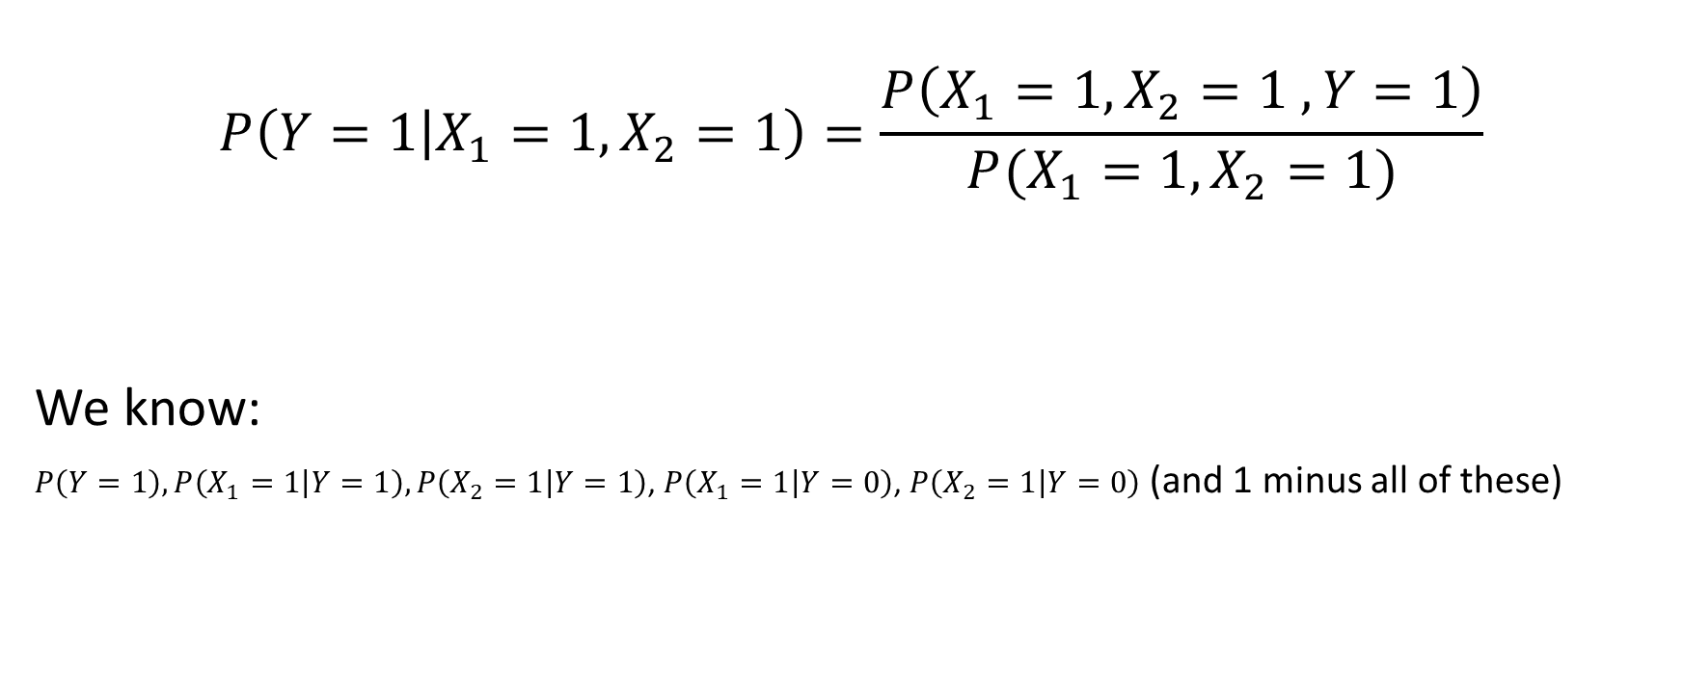
How should we classify a new video with the words “run” and “catch”?
$$P\left(Y=1 | X_{1}=1,X_{2}=1\right)=\frac{P\left(X_{1}=1, X_{2}=1 , Y=1\right)}{P(X_{1}=1,X_{2}=1)}$$
We know:
$P\left(Y=1\right), P\left(X_{1}=1 | Y=1\right),P\left(X_{2}=1 | Y=1\right)$, $P\left(X_{1}=1 | Y=0\right)$, $P\left(X_{2}=1 | Y=0\right)$ (and 1 minus all of these)

Slide 17
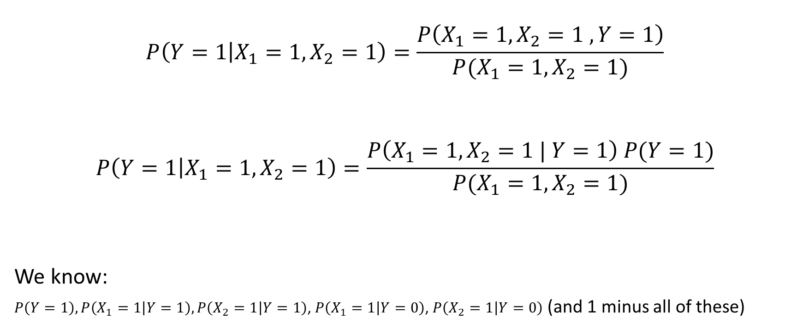
How should we classify a new video with the words “run” and “catch”?
$$P\left(Y=1 | X_{1}=1,X_{2}=1\right)=\frac{P\left(X_{1}=1, X_{2}=1 , Y=1\right)}{P(X_{1}=1,X_{2}=1)}$$
$$P\left(Y=1 | X_{1}=1,X_{2}=1\right)=\frac{P\left(X_{1}=1, X_{2}=1 | Y=1\right) P(Y=1)}{P(X_{1}=1,X_{2}=1)}$$
We know:
$P\left(Y=1\right), P\left(X_{1}=1 | Y=1\right),P\left(X_{2}=1 | Y=1\right)$, $P\left(X_{1}=1 | Y=0\right)$, $P\left(X_{2}=1 | Y=0\right)$ (and 1 minus all of these)

